Slide 1
Neural network - easy coding in Keras
From beginner to master in less then three hours
Startit Center Belgrade,
16.11.2019,
16:00-19:00

Slide 2
Milan M. Čugurović
Entusiast interested in DSC, especially ML
Master Mathematician and PhD Candidate in Informatics at Faculty of Mathematics, UB
TA @ MATF, BG
Member of ML Group at Faculty of Mathematics, UB
Member of CS Department at Faculty of Mathematics, UB

Slide 3

Faculty of Mathematics, UB
matf.bg.ac.rs/eng
more than 6000 graduate mathematicians
400 doctors of mathematics and computer sciences
700 Magisters of Science
many specialists etc.

Slide 4

ML@MATF
machinelearning.math.rs
Based at Faculty of Mathematics
Includes researchers, students and partitioners from various research institutions and leading IT companies
Led by professor dr Mladen Nikolić
Lectures/talks and practical sessions are held on every 2 weeks
Notes:
expert

Slide 5
Schedule:
Part I: ML basics / To fall in love with ML
Part II: NN basics / To take part in any ML project/community
Part III: Keras library / Learn basics of Keras
Lets meet these three goals and I will be pleased…
Notes:
Sedjual/timetable
plizd

Slide 6
ML basics

Slide 7
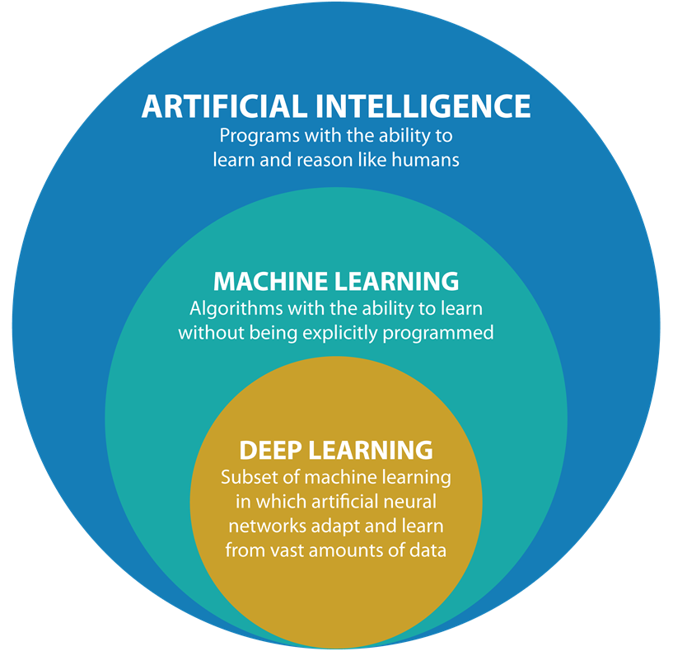


ML basics
Hottest CS topic currently
DL(NN) $⊂$ML $⊂$ AI
Very active research field today
Has accomplished amazing results
Built on multiple mathematical disciplines
Notes:
relative relationship

Slide 8
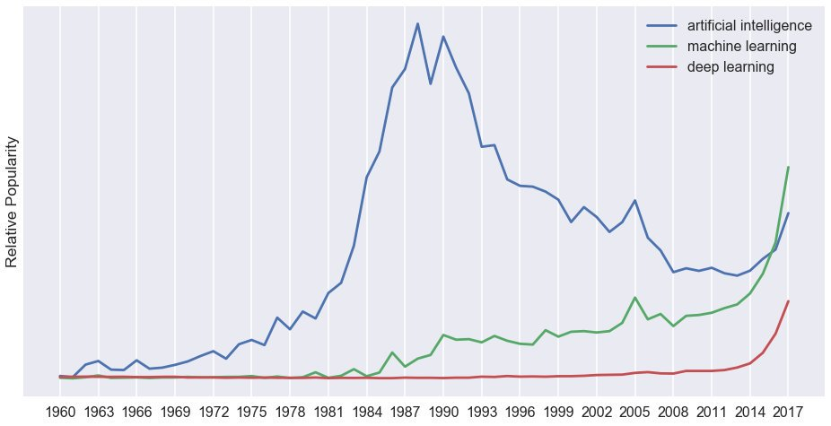
A little bit of Rita is all I need…*
Google trends
Notes:
Lou Bega - Mambo No. 5 (A Little Bit of...) (Official Video)
Google trends
Relatively popularity of AI, ML, and deep learning 1960 to 2017. Stitched from Google Ngram Viewer and Google Trends data.
I now understand the worries about another AI winter.

Slide 9
Definition of the term “learning”
How would you define the term “learning” ?

Slide 10
Definition of the term “learning”
Arthur Samuel (1959):
“Machine Learning is the field of study that gives computers the ability to learn without being explicitly programmed”
Herbert Simon (1970):
“Learning is any process by which a system improves performance from experience.”
Tom M. Mitchell (1998):
Machine Learning is the study of algorithms that:
improve their performance P
at some task T
with experience E
A well-defined learning task is given by <P, T, E>
Notes:
ABSENCE

Slide 11
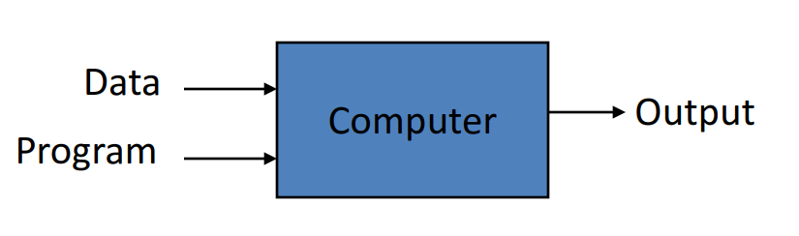
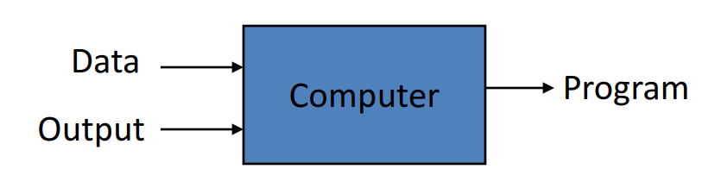
ML vs Traditional Programming
Notes:
Differrent point of view!
Handwritting recognition

Slide 12
Focus on me, Focus on me...*
Google: processes 24 peta bytes of data per day.
Twitter: 400 million tweets per day.
Facebook: 10 million photos uploaded every hour.
YouTube: 1 hour of video uploaded every second.
Astronomy: Satellite data is in hundreds of PB.
“By 2020 the digital universe will reach 44 zettabytes...” (44 trillion gigabytes)
The Digital Universe of Opportunities: Rich Data and the Increasing Value of the Internet of Things, April 2014
Notes:
Ariana Grande – Focus; process
1 petabyte = 1 000 000 gigabytes
Use accumulated data, learn from it!
EXPIRIENCE!

Slide 13
Some ML results
1992 - TD-Gammon, computer program developed by Gerald Tesauro able to play backgammon
2011 - IBM’s Watson wins in quiz Jeopardy!
2012 - Google X creates system able to recognize cats on video recordings
2015 - Classification error for images reduced to 3.6% (5-10% is the error made by humans)
2016 - Google creates AlphaGo, agent able to play Go who beats the world champion 4:1
2017 - AlphaGo plays against its 2016 version and wins 100/100 games
October 2017 - AlphaGo Zero learnt to play the game of Go simply by playing games against itself, starting from scratch (40 days)
2018 - Humans are miserable compared to ML (any area)

Slide 14
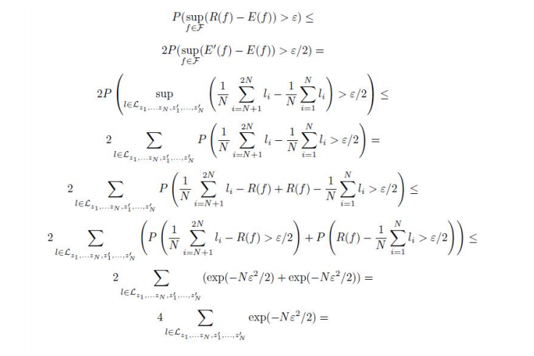
But why is it so successful and popular today?
There is serious amount of mathematics behind [Murphy, 2012, Bishop, 2006, Hastie et al., 2001, Shalev-Shwartz and Ben-David, 2014, Vapnik, 1995]
Notes:
Don’t be afraid, today we talk ML introduction without so much math stuf
Big amounts of data
We also have graphical cards with thousands of processors
Industry and academia complement each other
Our meeting here today is the evidence of that :)

Slide 15

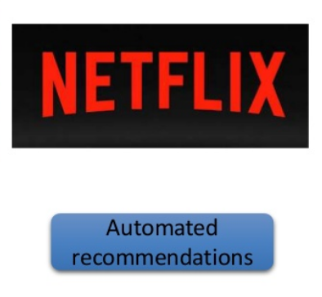
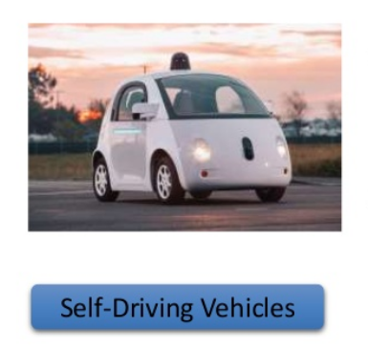
Some ML Applications
Web search
Computational biology
Finance
E-commerce
Space exploration
Robotics
Information extraction
Social networks
Debugging software
[Your favorite area]
Notes:
J just will highlight some of them

Slide 16
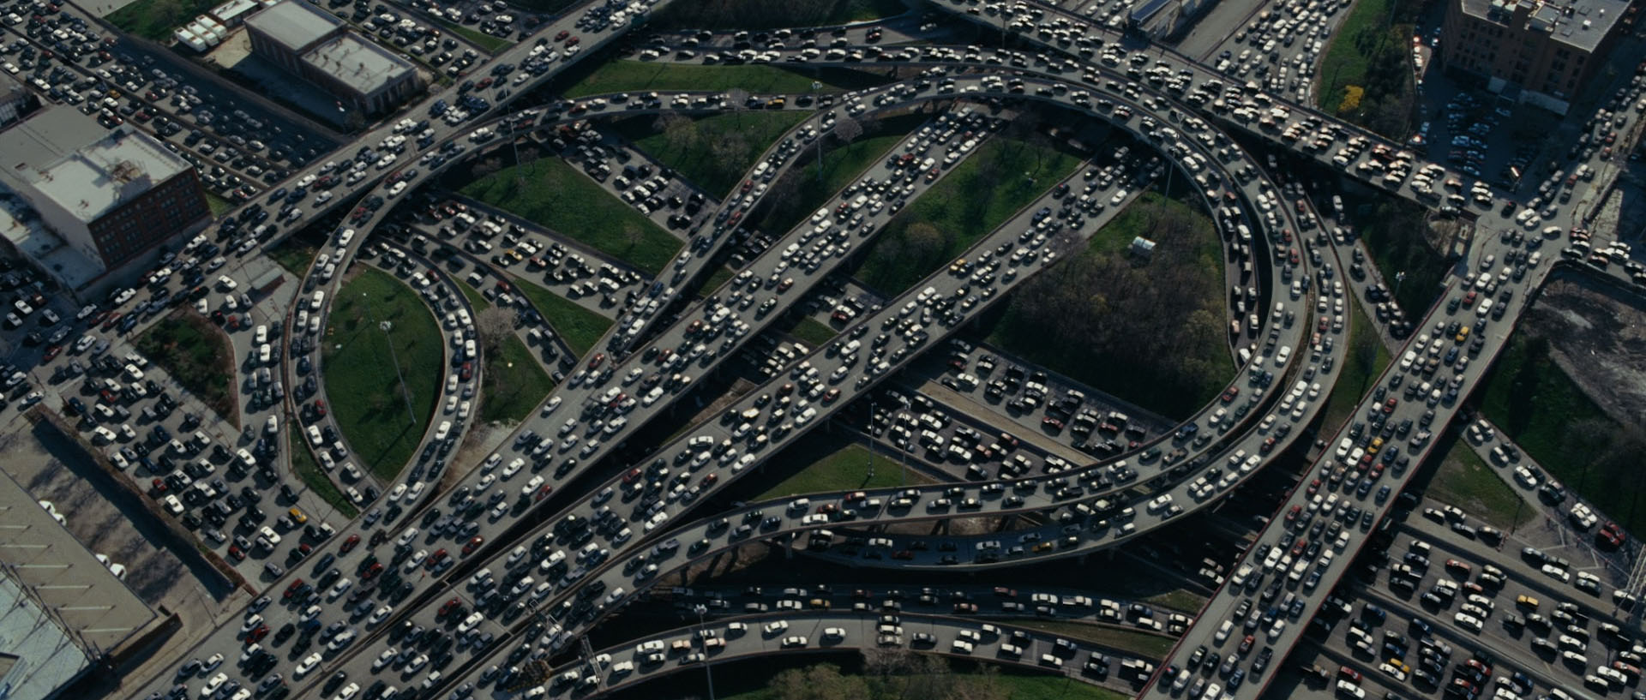
Example 1: Autonomous Cars youtube.com/watch?v=NLzakmRgEAs (Gyratory traffic)

Slide 17
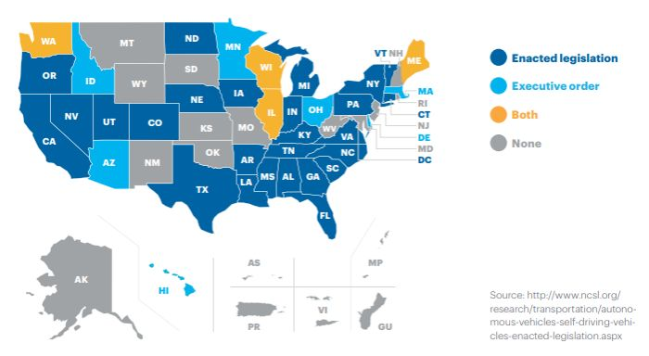
Example 1: Autonomous Cars
June 2011: Nevada made it legal for autonomous cars to drive on roads
2013: Nevada, Florida, California, and Michigan have legalized autonomous cars
Now:
Notes:
Executive order: a rule or order issued by the president to an executive branch of the government and having the force of law.

Slide 18
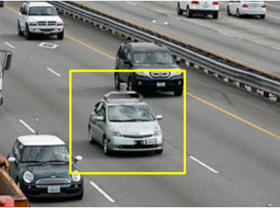
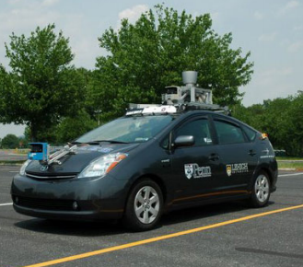
Example 1: Autonomous Cars
Detecting it
Penn’s Autonomous Car ((Ben Franklin Racing Team)
Notes:
Its weird

Slide 19
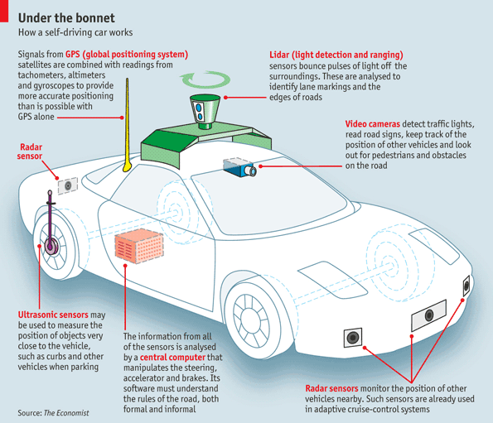
Example 1: Autonomous Cars
Notes:
Autonomous Car Sensors
https://circuitdigest.com/article/debunking-the-magic-behind-sensors-used-in-self-driving-cars

Slide 20
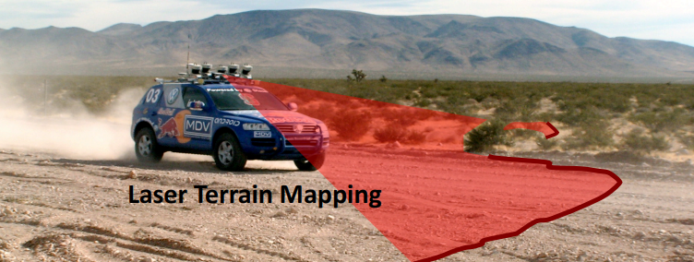
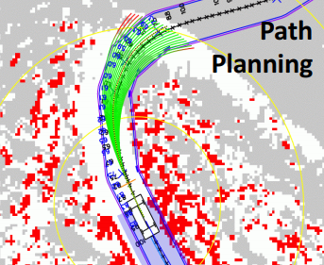
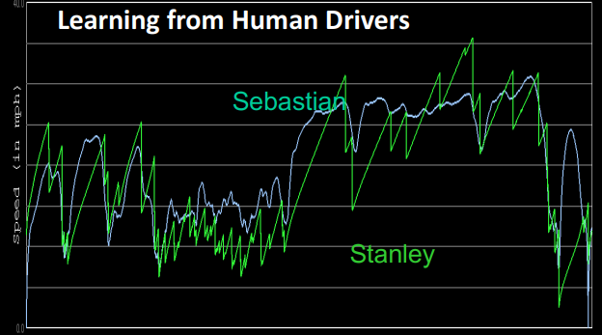
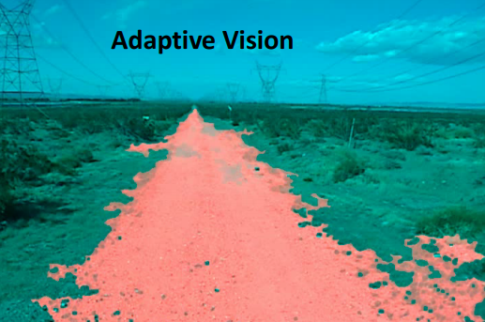

Slide 21
Example 1: Autonomous Cars
Tesla: https://www.youtube.com/watch?v=tlThdr3O5Qo
Wayve: https://www.youtube.com/watch?v=26Or4QbLbMM
Audi A8 Parking: https://www.youtube.com/watch?v=Cwcoi-HlZ-M

Slide 22
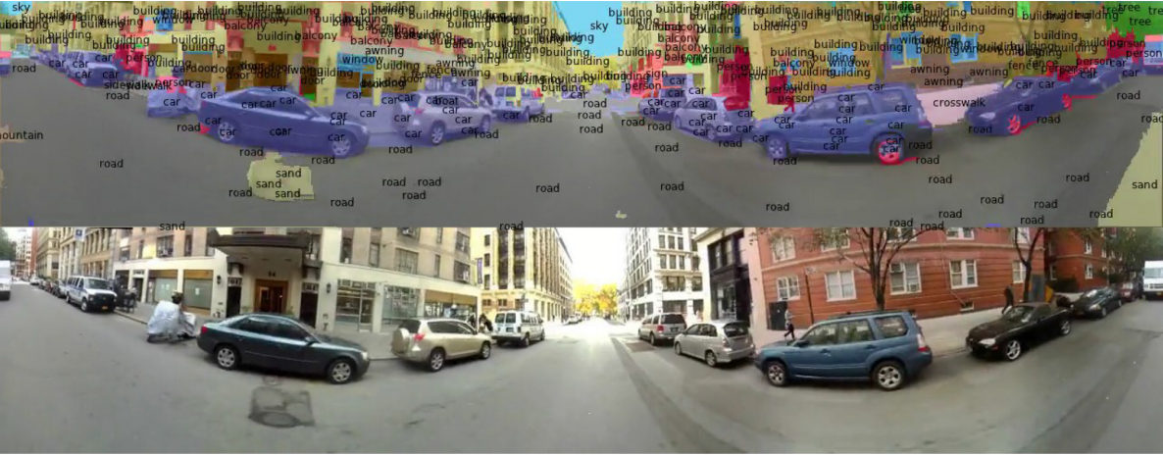
Example 2: Scene Parsing/Labeling via DL
Background/Motivation?
Scene parsing: labeling each pixel in the image with category of the object to which it belongs
Important step toward image understanding
Notes:
We have enough motivation from the previous example
Add how it is solved

Slide 23
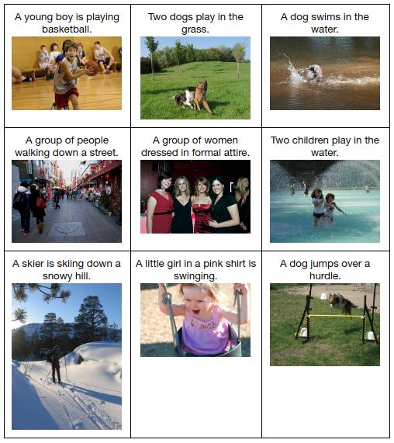
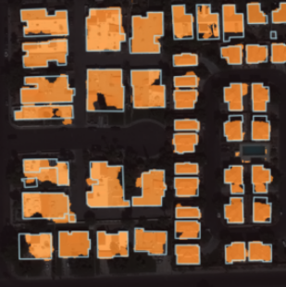
Example 2: Scene Parsing/Labeling via DL
Image -> Video
https://www.youtube.com/watch?v=N1f7i-oItWU
To Train DL Models on Satellite Imagery
Image captioning
Notes:
Video is just stack of frames

Slide 24
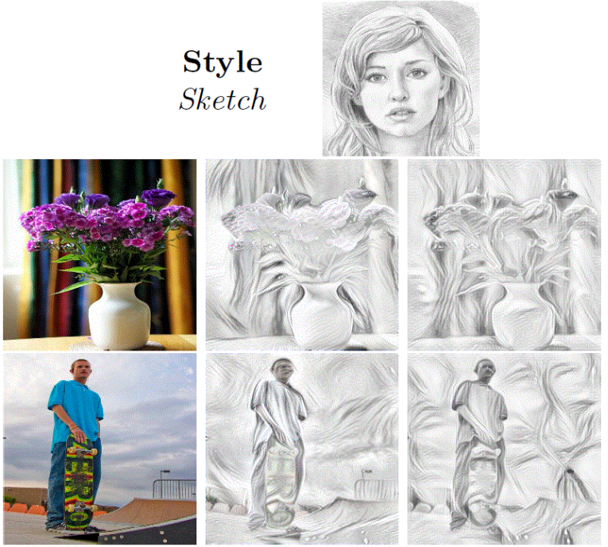
Example 3: Style Transfer
My lecture at ML@MATF Seminary:
http://machinelearning.math.rs/Cugurovic-Style.pdf

Slide 25
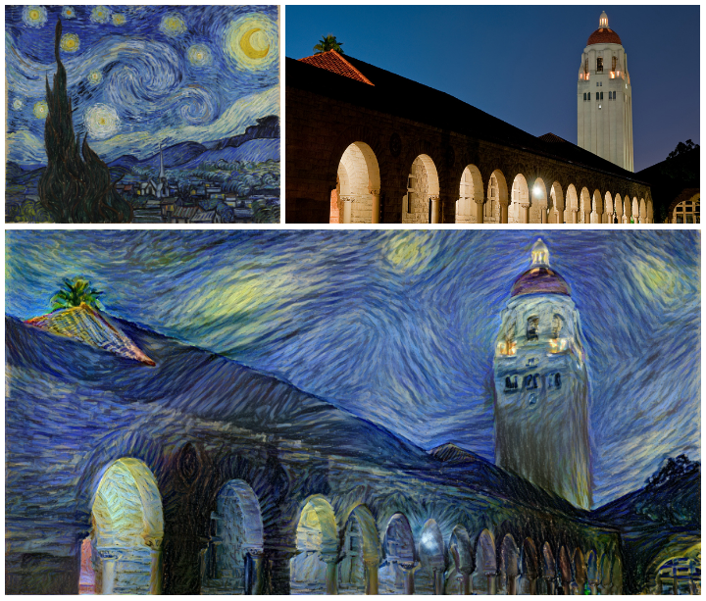
Example 3: Style Transfer
The Starry Night, 1889
Oil on canvas
By the Dutch post-impressionist painter Vincent van Gogh
The Stanford campus photo
Notes:
We can even more, not just a handwritten scratch of anonimus authors
The Starry Night is an oil on canvas by the Dutch post-impressionist painter Vincent van Gogh.
the artistic style of The Starry Night onto a night-time photograph of the Stanford campus:

Slide 26
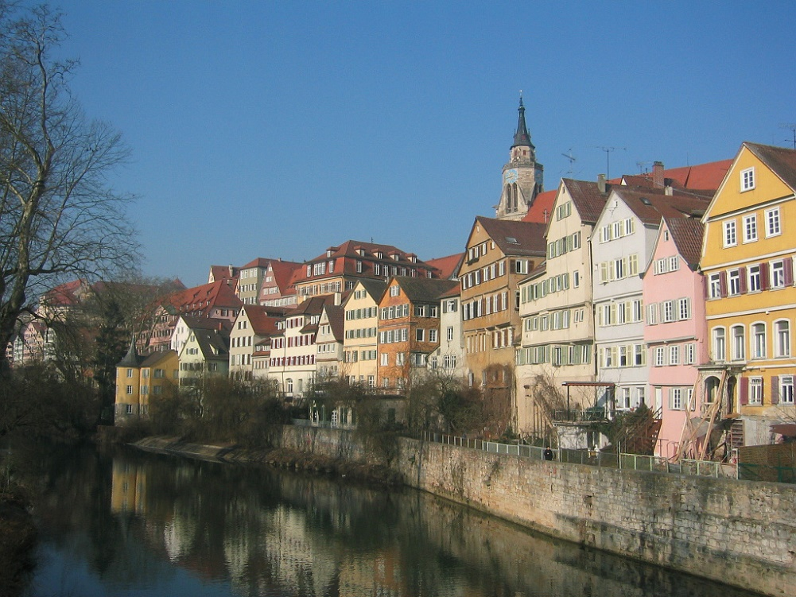
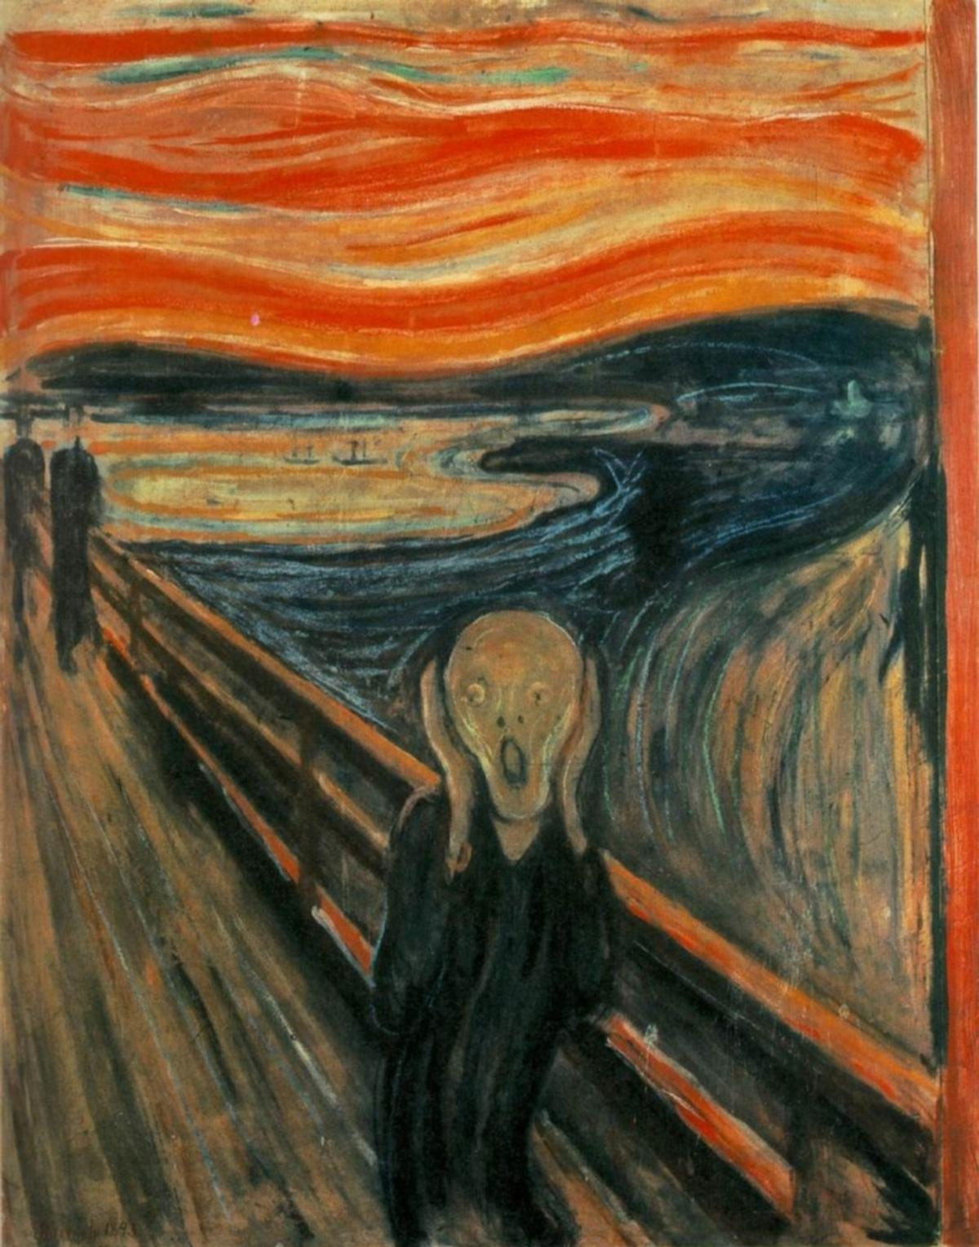
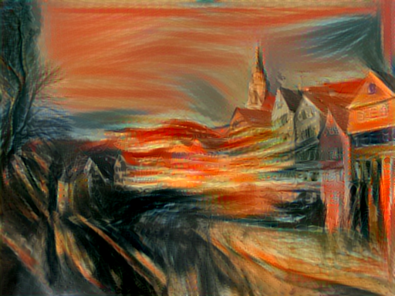
Example 3: Style Transfer
The Scream, 1893
A composition created by Norwegian Expressionist artist
Edvard Munch
Tubingen, Germany
Notes:
The scream
The Scream is the popular name given to a composition created by Norwegian Expressionist artist Edvard Munch in 1893.
Tubingen Germany, Leon Gaytes university (just casual images)

Slide 27
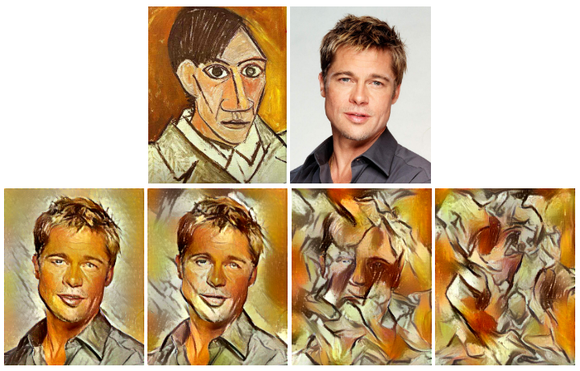
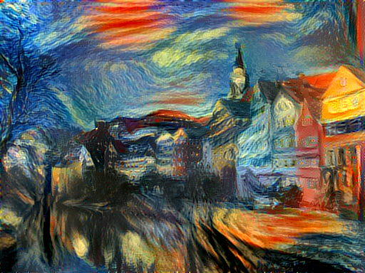
Example 3: Style Transfer
Combine them
The style of Picasso's 1907 self-portrait onto Brad Pitt, etc.
Notes:
Weight how much style we want!

Slide 28
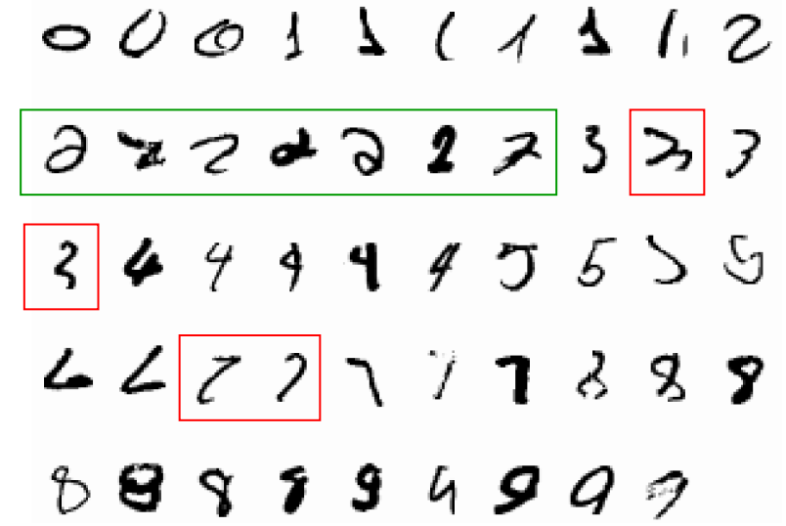
Example 4: Handwriting Recognition
It is very hard to say what makes a 2
There were “manual” methods for recognizing handwritten characters before
ML (DNN) a few orders of magnitude better

Slide 29
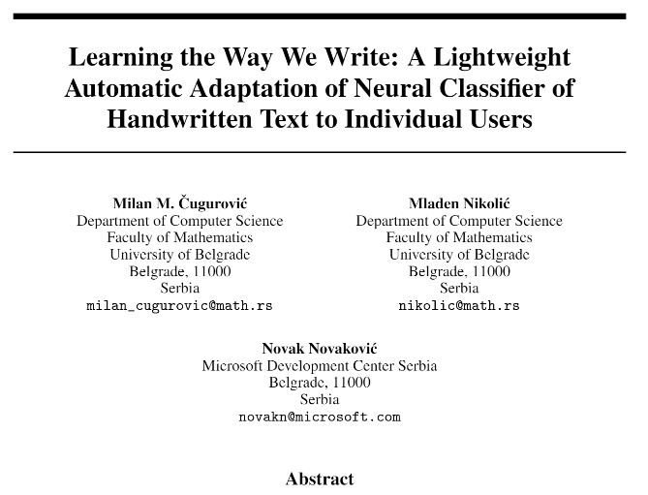
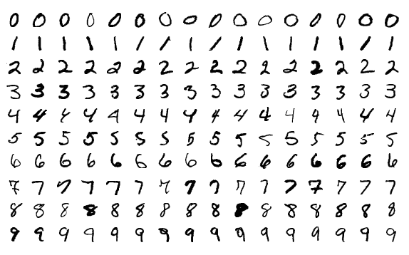
Example 4: Handwriting Recognition
We currently working on it
Try to further improve deep CNN

Slide 30
NN basics

Slide 31
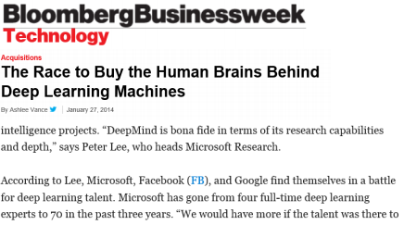
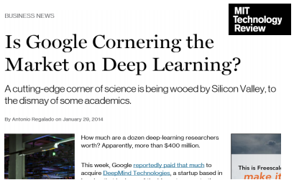
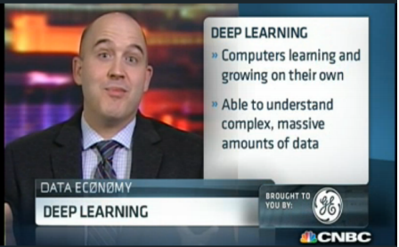
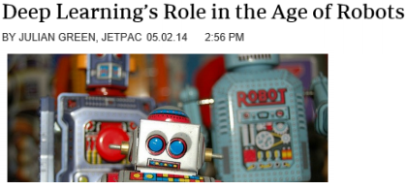
NN == DL
Can see it everywhere
The idea of mimicking the human brain

Slide 32
Neural Networks - First Look
Most popular and most appropriate machine learning methods
Five main types:
Feed Forward neural network (basic)
Convolutional neural network (images)
Reccurent neural network (memory)
Recursive neural network (tree)
Graph neural network (graph)
As we said before:
Medical diagnostic
Image recognition and Object detection
Autonomous driving
NLP (Natural Language Processing)
Go, FlappyBird ...
The reason for their re-popularity (computational power – GPU!)

Slide 33
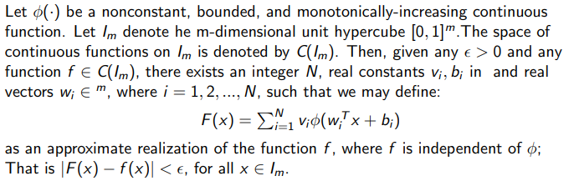

Before we dive in...
Biological motivation and connection
Neuron - the basic computational unit of the brain
Around 86 billion neurons can be found in the human nervous system
They are connected with approximately ${10}^{14}−{10}^{15}$ synapses
Human ’training process’ - a couple of years :) (AlphaGo 40 days right now)
Mathematical strength
Universal approximation theorem:

Slide 34
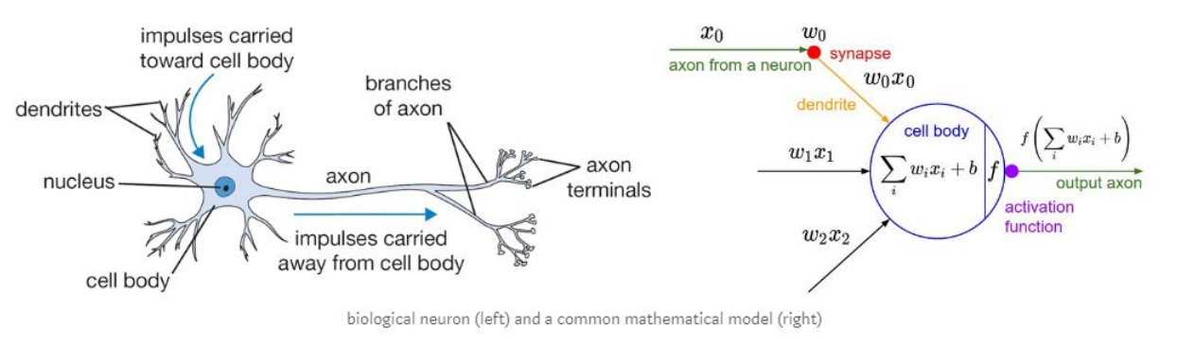
Main parts of Feed Forward Neural Network
Neuron:
Notes:
Impulses carried toward cell body

Slide 35
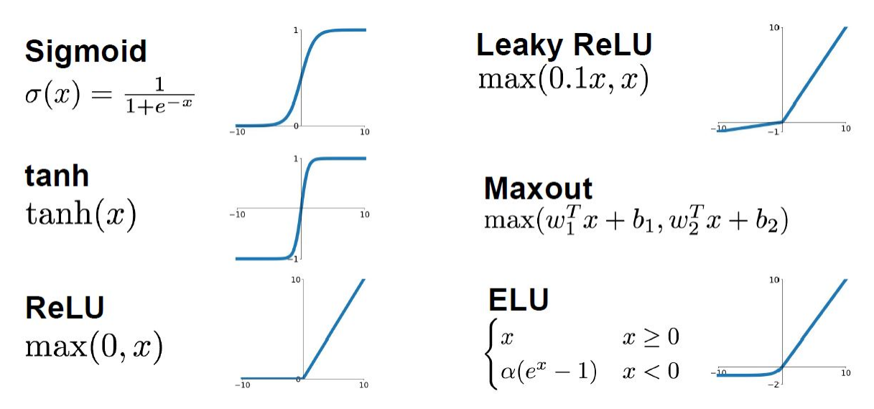
Main parts of Feed Forward Neural Network
Activation function:

Slide 36
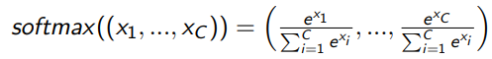
Main parts of Feed Forward Neural Network
Neurons (with its activation functions) are stored in layers
Input layer - No computation is done here within this layer, they just pass the information to the next layer
Hidden layers - they perform computations and then transfer the weights (signals or information) from the input layer to the following layer (another hidden layer or to the output layer)
Output layer - Here we finally use an activation function that maps to the desired output format (e.g. Softmax for classification):

Slide 37
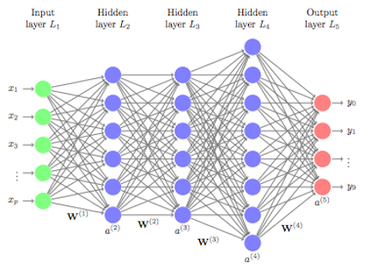
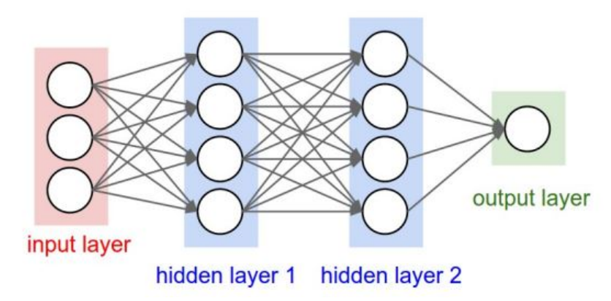
Main parts of Feed Forward Neural Network
Fully image:
FC for classification
FC for regression

Slide 38
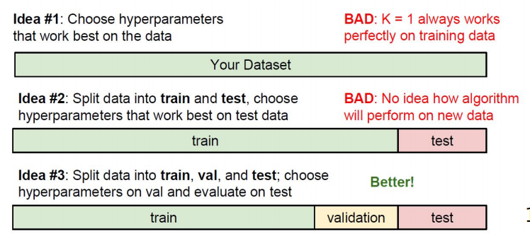
Dataset split (coding scenario)

Slide 39
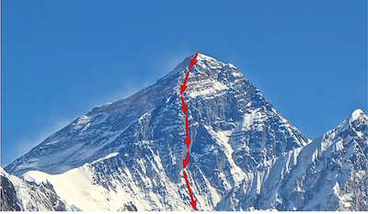
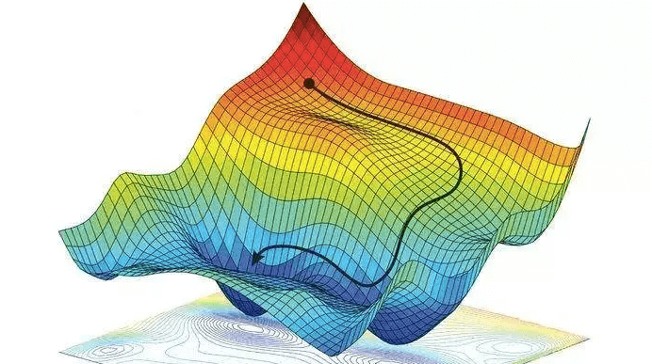
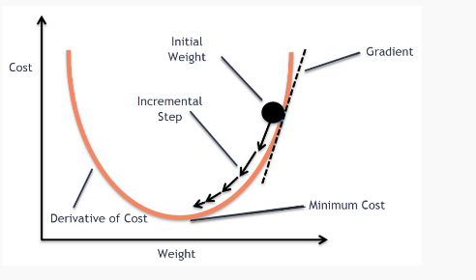
Gradient descent
Find the minimum of a function
Iteratively search for a minimum
The direction of the fastest descends
Notes:
Rolling down the hill

Slide 40
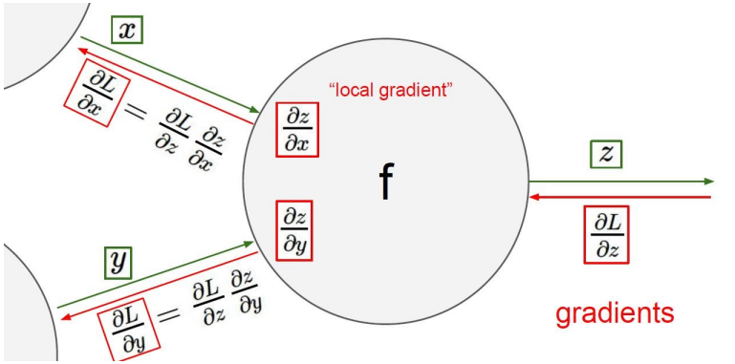
Backpropagation
Global optimization problem
Fine tune weights

Slide 41
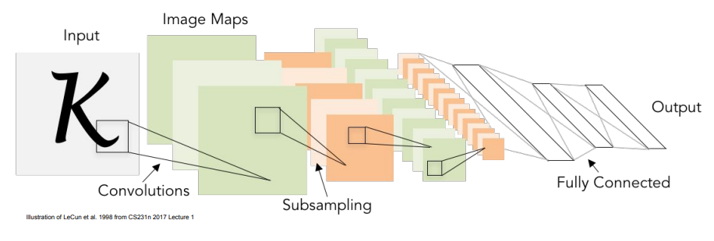
CNN
Extensively use in Computer Vision tasks
Raw signals (voice, images, …)
ConvNets stack CONV,POOL,FC layers
Notes:
Best solver for raw signal input

Slide 42
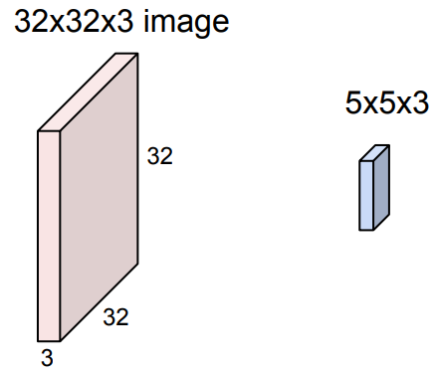
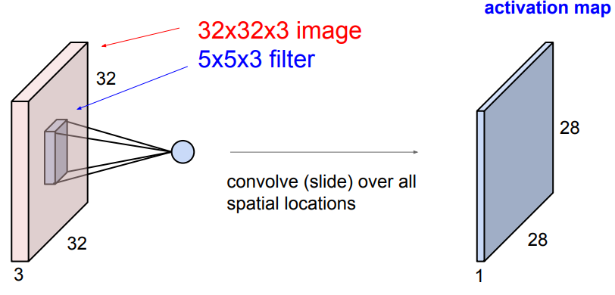
Convolution layers
Convolve the filter with the image
“slide over the image spatially, computing dot products”

Slide 43
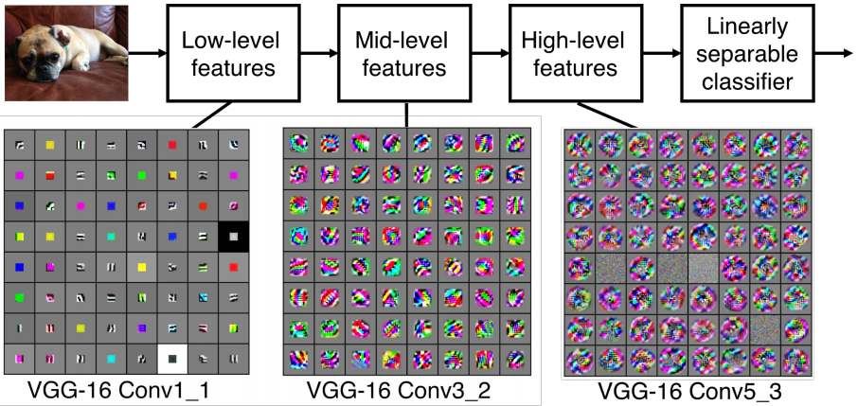
Convolution layers

Slide 44
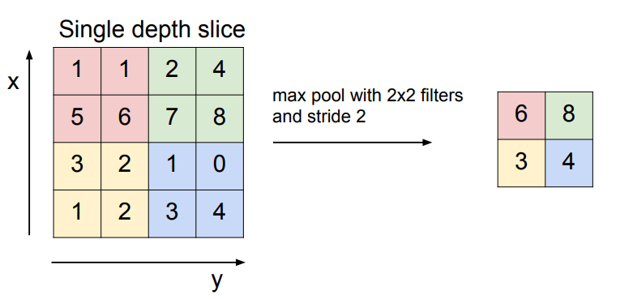
Pooling layers
Max Pooling, Average Pooling, etc.
Makes the representations smaller and more manageable
Notes:
et cetera

Slide 45

Keras Library
keras.io

Slide 46
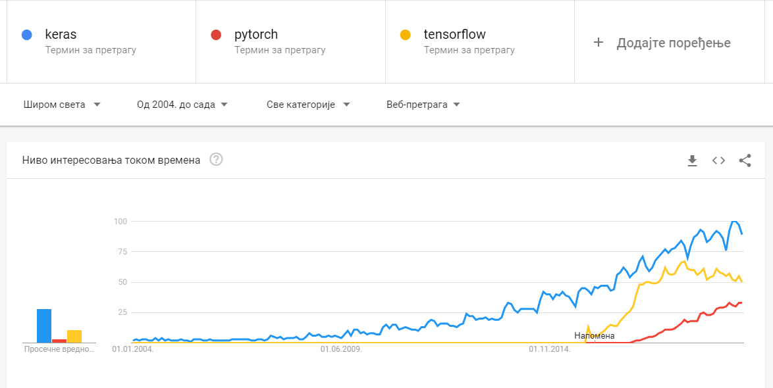
Keras (κέρας)
Notes:
means horn in Greek

Slide 47


Without cheating
Why Keras?
powerful
easy-to-use
open source
Notes:
It wraps the efficient numerical computation libraries Theano and TensorFlow and allows you to define and train neural network models in just a few lines of code.

Slide 48


Coding time
Go to drive.google.com/
Create new folder

Slide 49


Coding time
Connect with Google Colab
Go to: colab.research.google.com/
Enjoy coding!

Slide 50

Example 1
Pima Indians onset of diabetes dataset
Predict diabetes

Slide 51

Example 2
Notes:
Trains a simple deep NN on the MNIST dataset.
Gets to 98.40% test accuracy after 20 epochs

Slide 52

Example 3
Ex2_MNIST_CNN.ipynb
Trains a simple ConvNet on the MNIST dataset.
Gets to 99.25% test accuracy after 12 epochs

Slide 53
Thank you
milan_cugurovic@matf.bg.ac.rs
milancugurovic@gmail.com
+381 65 69 24 577
matf.bg.ac.rs/milan_cugurovic (in Serbian only)
linkedin.com/in/milancugurovic
github.com/MilanCugur

